Slide 1
Sales & Financial Performance Dashboard
Project Introduction
TOOL
DATASET
OBJECTIVE
Microsoft Power BI
Superstore Sales Dataset
Analyze sales and profit performance
Presented by Vismaya B

Slide 2
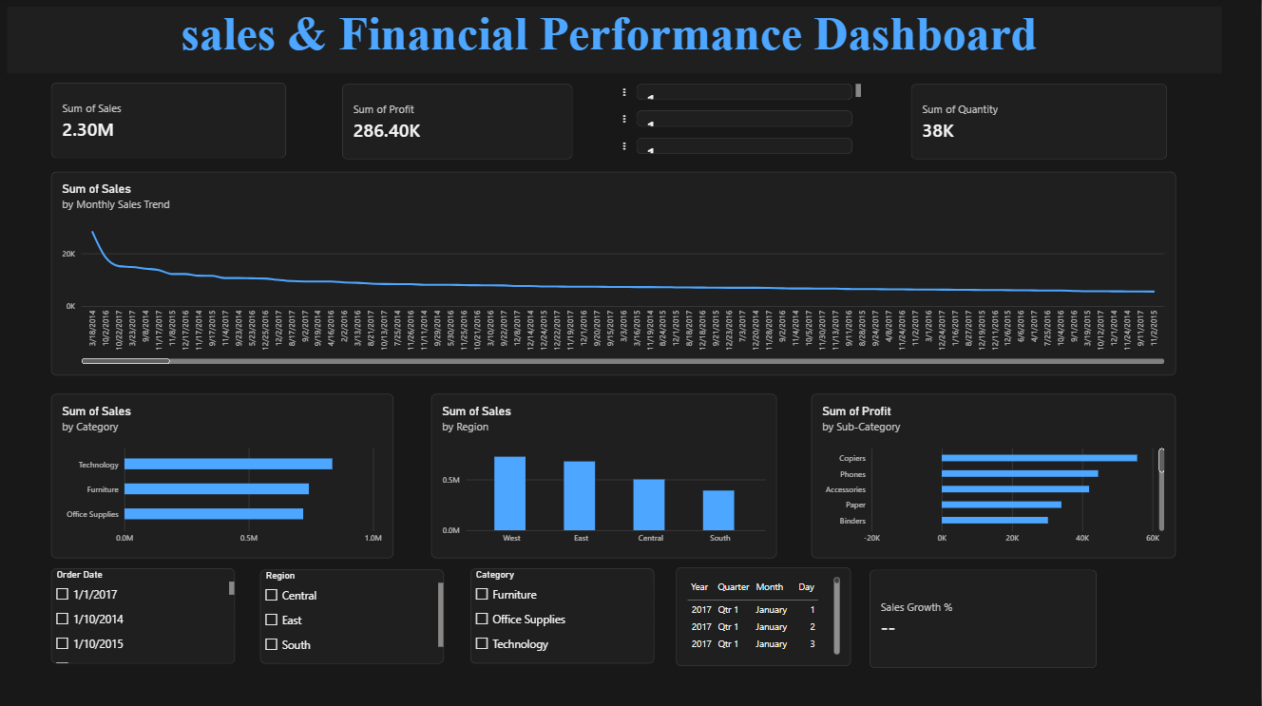
Dashboard Overview
Key metrics
2.30M
Total Sales
286.40K
Total Profit
38K
Total Quantity
Also on the dashboard: Sales Growth and Monthly Sales Trend, with slicers for Order Date, Region and Category.
2

Slide 3
Key Business Insights
Top region
Product categories
West leads sales, followed by East, Central and South.
Technology has the highest sales, ahead of Furniture and Office Supplies.
Sub-category profit
Monthly trends
Copiers and Phones are the most profitable sub-categories, followed by Accessories.
The monthly sales trend and date slicers show how sales move over time.
3

Slide 4
Conclusion
1
Interactive dashboard helps monitor business performance
2
Slicers make data exploration easier
3
Visualizations support better business decisions
4

